Slide 1
Computer Graphics Camera
László Szécsi szecsi@iit.bme.hu
AIT

Slide 2

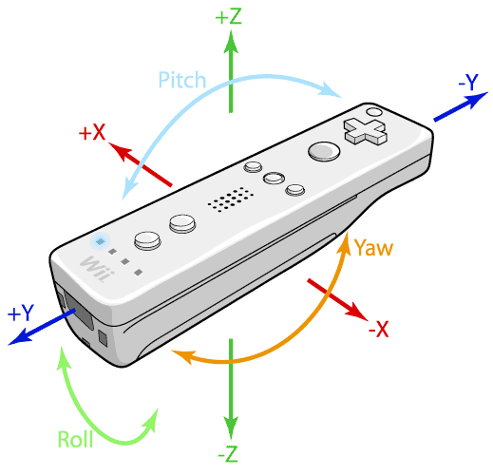



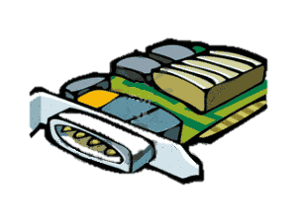

2D computer graphics
output pipeline
input pipeline
event handling
display
device
control
editing
animation
physical simulation
graphics
hardware
model
virtual world
numerical representation
rendering
modeling
analogy:
drawing shapes
on paper
Notes:
We have discussed the modeling process so far—at least to the point of specifying positions with coordinates. We revisited the mathematical machinery for transformations. Now it is time to talk about the rendering side. The virtual world model has been built, and we need to display it to the user.

Slide 3

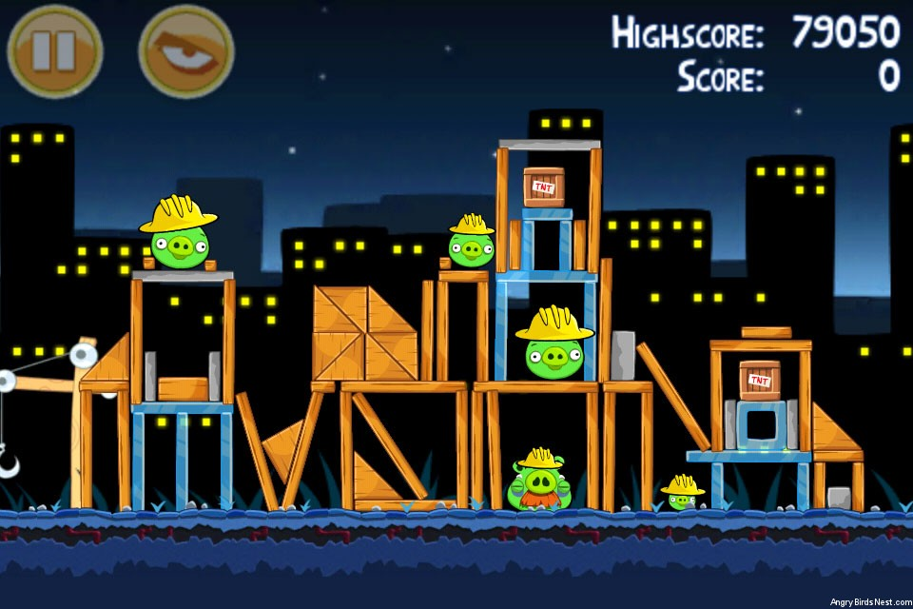
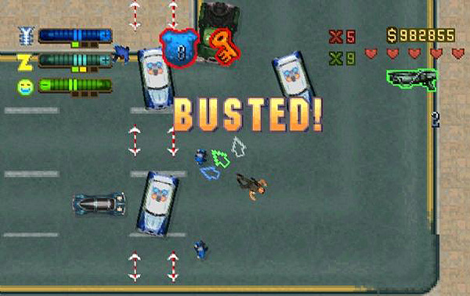
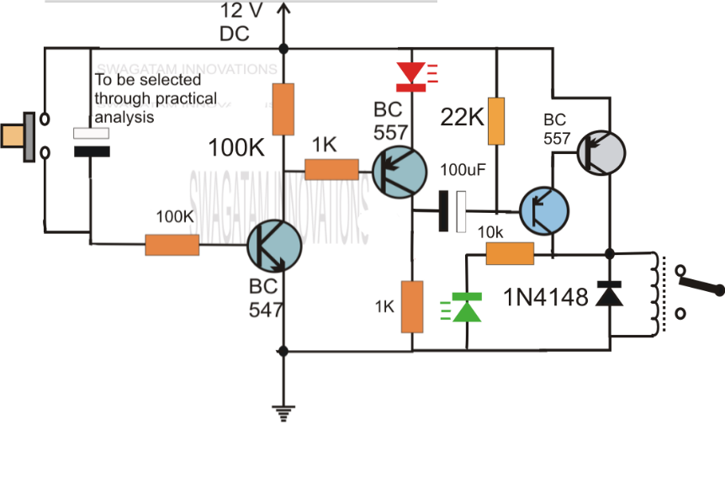
2D graphics systems
Notes:
Let us think about some examples of 2D graphics systems. Examples abound. Pretty much every piece of software that does have a visual interface and is not predominantly 3D can be seen as a 2D graphics system. Prezi, PowerPoint, or even Word? Yes. Adobe Reader? Absolutely. Adobe Illustrator? It is even a 2D editor!
Computer aided design (CAD) systems, integrated circuit planners, they are 2D graphics systems – not saying they might not include 3D, too.
And there are games. With online flash games, WebGL, and mobile apps, 2D graphics systems are omnipresent.

Slide 4
2D virtual worlds
The virtual world is a collection of objects
All objects have their own positions, orientations, or even scalings or shearings
But multiple objects may use the same model
may consist of geometry
curves, polygons, shapes
and texture
sprites
Notes:
A quite general way to look at virtual worlds is to see them as collections of objects (a.k.a. entities, or, in case of games, game objects). It is instantly obvious that some objects are similar, differing only in their poses (their positions and orientations, sometimes even their size). We can say that these objects share a common model, but have their own pose.
What makes a model? So we alluded to triangles meshes used as geometric models. But in our examples we saw that pre-drawn images are also used, and often look nicer then what polygons could achieve. These image elements are often called sprites.
Some graphics systems support copying pixel colors from generic memory to video memory (a fast process known as blitting), without free rotation or translation (the C64 computer of old even had dedicated sprite memory).
Today we use graphics libraries capable of rendering 3D geometry. Displaying images in OpenGL will be accomplished by applying those images onto polygons as textures. Free rotation and scaling, with appropriate resampling of the texture images to the pixels of the frame buffer, will be performed by the graphics system. Thus, we will focus on geometries, and mind texturing them later.

Slide 5
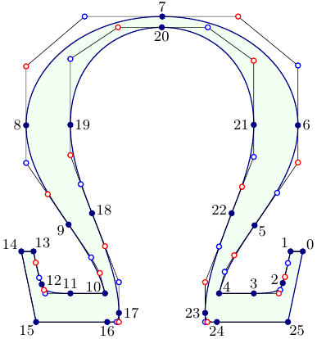


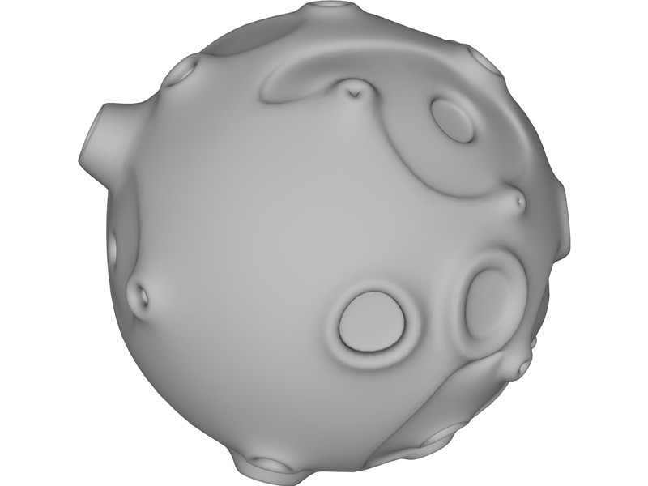
Models
Notes:
A model is a piece of geometry, an image, or the combination of the two. Geometry is specified through points, which needs a coordinate system. The coordinate space we define a model in is called the model space.
Models are usually too complex to be described by a single triangle, polygon, or curve. These basic constructs are referred to as primitives, and a model is a collection of primitives. Operations like draw, pick, etc. are mathematically defined for the primitives, and implementing them for the model means performing them for all the primitives.

Slide 6
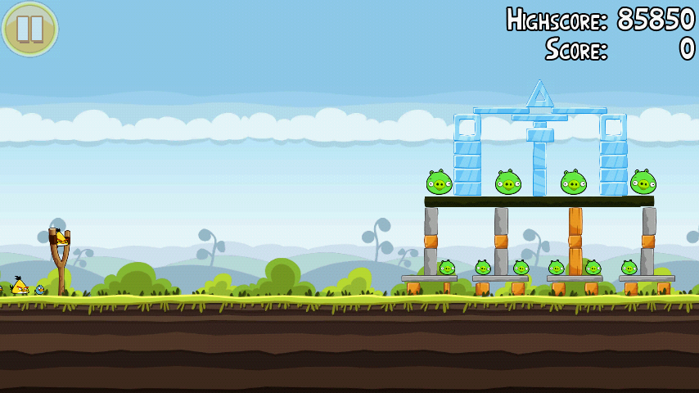
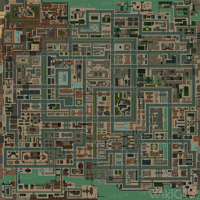
Worlds
Notes:
A 2D virtual world is composed of model instances, or objects. Where and in what pose those objects are must be given according to some reference system. This reference system is the world coordinate space.
There is one world space (for one 2D virtual world). We can draw the model coordinate axes for all the objects. This is easy to see as having multiple “object spaces”, using coordinates relative to the red coordinate axes. But note that there is no difference between the model space and the object space: the coordinates of the left ear of a pig w.r.t their own axes will be the same no matter which instance of the same model we consider.
Thus we could say that objects (a.k.a. model instances) define the mapping between model space and world space --- as they have their own positions and orientations. This mapping is unique for each object. The mapping will be described by a transformation, meaning all objects will have their own model transformation.
The terms object space and model space can be used synonymously.

Slide 7
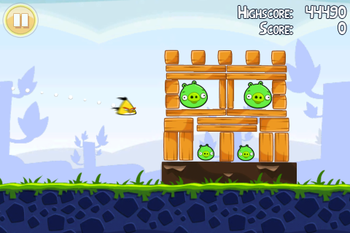
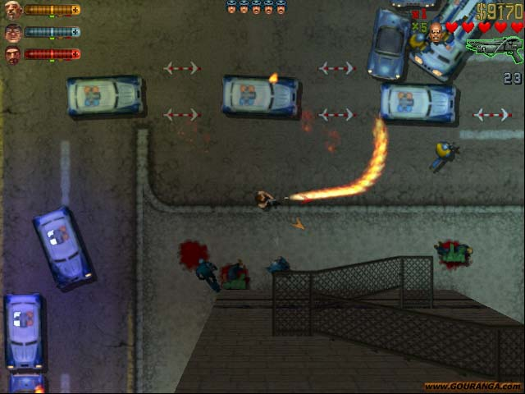
Visible window / 2D camera
Notes:
Not all of the virtual world is visible at a given time. We may pan the view, scroll the contents, zoom in or zoom out.
The part of the virtual world that is visible is called the window (not to be confused with the operating system window in which our viewport might be located). Because of the aforementioned panning and zooming capabilities, the window behaves quite like a real-life camera. The term '2D camera' is also applicable.
We can of course talk about position of points in the camera window. This is another coordinate space, and we can think of the camera as a mapping from world space coordinates to window space coordinates. Therefore, the 2D camera will be described by a transformation called the view transformation.

Slide 8
Transformations
Given the coordinates of a point in one space, what are its coordinates in another space?
static interpretation
What should I do with the original coordinates, to get them in another space?
dynamic interpretation
Notes:
Transformations are operations on points. The point is expressed by a set of coordinates. A transformation will yield a new set of coordinates. This can simultaneously be seen to:
a, calculate coordinates for the same point in a different space (this I will call the static interpretation)
b, change the coordinates of the point, moving it (the dynamic interpretation).
Both interpretations are valid. The static one tells us what the purpose of the computation is, the dynamic often helps us in its construction.
Transformations are a way to compute answers to questions we will be encountering in graphics, and incremental image synthesis in particular. Questions like:
If the modeler has drawn this vertex here, and the object is standing here, where in the world is the vertex?
If the triangle was modeled here, where should we draw it on screen?

Slide 9
The 2D image synthesis problem
given a 2D model
triangle vertices [model coordinates]
a 2D triangle drawing algorithm
colors pixels [viewport coordinates]
The task:
from the model coordinates of the vertex, compute in which pixel it appears
Notes:
Graphics libraries (like WebGL or OpenGL) or graphics hardware just draws points, line segments, and triangles on-screen. The task really is, given the models in the reference model spaces, where to draw those triangles on-screen, what pixels to color.
For a single triangle vertex point, this means a long journey of computations (transformations!) to find out where it actually appears on the display device.
Also, the transformations must take triangles and yield triangles. The class of transformations which has this property is called the class of homogeneous linear transformations. As they are linear, they can be written as a multiplication with a matrix. It is a 4x4 matrix, as it works on homogeneous coordinate quadruplets.

Slide 10
What would influence this?
Where our model is placed in the virtual world
model transformation, a.k.a. (world transformation)
Where the camera is, how zoomed-in it is
view transformation
How large pixels are
viewport transformation
Notes:
What are the parameters of such a computation? What influences where a vertex ends up on the screen?
Where our model is placed in the virtual world.
This is defined by the model transformation parameters, a.k.a. (world transformation).
Where the camera is, how zoomed-in it is.
Defined by the camera parameters. The computation using these is the camera transformation.
How large pixels are
Handled by the viewport transformation.

Slide 11
2D rendering pipeline
OpenGL
world
space
reference state
(model space, object space)
model
transform
vectorization
window
view transformation
Screen or appwindow
clipping + viewport transform
viewport
viewport
(1,1)
Rasterization
(-1,-1)
normalized device space
Screen
Notes:
2D rendering is a sequence, or a pipeline, of computation steps. We start with the objects defined in their reference state, which can include points, parametric or implicit curves, 2D regions with curve boundaries. As we shall transform these objects, they are vectorized, so curves are approximated by polylines and regions by polygons. The rendering pipeline thus processes only point, line (polyline) and triangle (polygon) primitives.
The model transformation places the object in world space. This typically involves scaling, rotation and translation to set the size, orientation and the position of the object. In world, objects meet each other and also the 2D camera, which is the window rectangle. We wish to see the content of the window in the picture on the screen, called viewport. Thus, screen projection transforms the world in a way that the window rectangle is mapped onto the viewport rectangle. This can be done in a single step, or in two steps when first the window is transformed to a square of corners (-1,-1) and (1,1) and then from here to the physical screen. Clipping removes those object parts that are outside of the camera window (in world space). Or saying the very same thing, it removes parts outside of the viewport (in screen space). If the coordinate system to measure position w.r.t the window are such that the window corners are corners (-1,-1) and (1,1), then clipping must be performed to this origin-centered 2-edge-length square. The window space is called the normalized device space for this reason. The advantage of normalized device space becomes obvious now. Clipping here is independent of the resolution and of the window, so can be easily implemented in a fixed, non-programmable hardware. Having primitives transformed on the screen, where the unit is the pixel, they are rasterized. Algorithms find those sets of pixels which can provide the illusion of a line segment or a polygon.

Slide 12





Transformation pipeline
model
transform
view
transform
viewport
transform
model space
world space
clip space
norm. device space
pixel
coordinates
window
space
modelling
Notes:
The task of computing the pixel coordinates of a vertex from the modeling coordinates is performed by a series of transformations. Originally, the vertices are given in model space, then transformed to world space using the model transform, to camera space (a.k.a. NDC, or clip space, for clipping will be performed using these coordinates) using the view transform, and finally to pixel coordinates using the viewport transform.
All the transformations take a 3-element homogenous 2D coordinate vector, and return a 4-element homogenous 2D coordinate vector. All transformations are linear in homogenous coordinates, they can all be written as 3x3 matrices. Transformation is multiplication by that matrix. A series of transformations can be performed as a single multiplication by a single compound transformation matrix obtained as a product of the element transformations.

Slide 13
Model and world coordinates (static interpretation)
model
world
Notes:
Recall that the virtual world contains model instances in different poses. The model transformation computes the world space coordinates of a model vertex for an object in a certain pose.
This interpretation tells us what we want to compute, but how the pose should be specified is not intuitive.

Slide 14
Model and world coordinates (dynamic interpretation)
Notes:
We can see this computation to move the model from its original reference position and orientation to its proper world pose. The transformation can be constructed a rotation for the orientation, and a translation for the position.
So, performing a rotation and a translation will compute world space coordinates from model space coordinates. The transformation can be said to take the model from model space to world space. This interpretation is useful for the construction of the model transform.

Slide 15
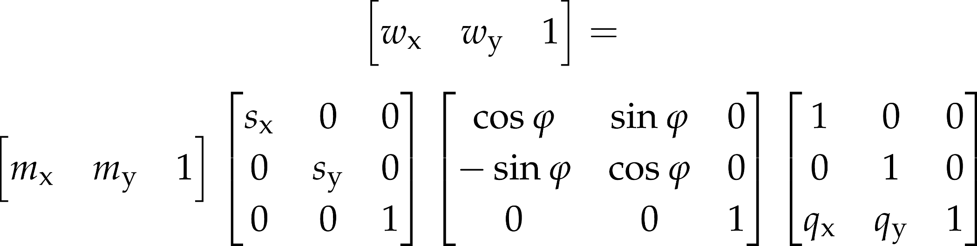
Constructing a model transformation
from
vertex
buffer
Notes:
When we are placing the object in the virtual world, we often want to think about this in human-interpretable terms. The notions of size, orientation and position are straightforward. A model matrix for such a pose can be constructed as a concatenation of a scaling, a rotation, and a translation.
As scaling and rotation are wrt. the origin and the coordinate axes, the order of transformations is important. If we first rotate then scale, then the object will be not be scaled along its model space axes. If we first translate, then rotate, then the object will not be rotated in place, but it will orbit the origin.

Slide 16
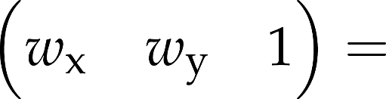
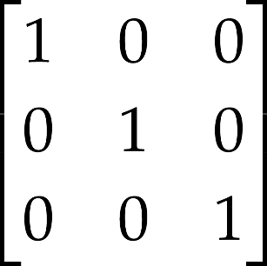
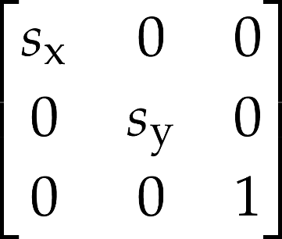
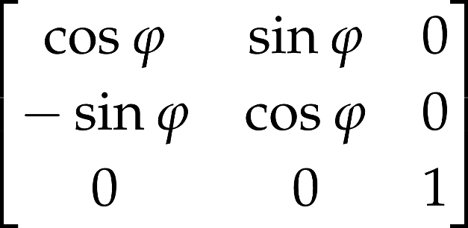
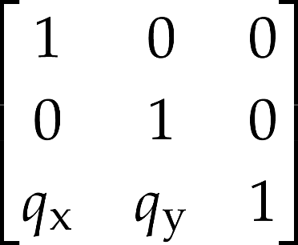
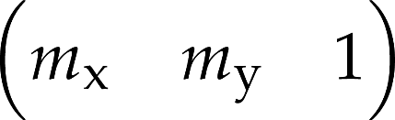
Constructing a model transformation
from vertex buffer
new Mat4()
.scale(sx, sy)
.rotate(phi)
.translate(qx, qy)
compose matrix on host
vector-matrix multiplication happens in the shader

Slide 17
View transformation – 2D camera, OrthoCamera
Where does this vertex go on the screen?
also:
What do I do with everything in the world, to get this part in particular on my screen?
1
1
Notes:
Screen projection maps the window rectangle, which is the camera in 2D, onto the viewport rectangle, which can be imagined as the photograph. This simple projection is usually executed in two steps, first transforming the window onto a normalized square, and then transforming the square to the viewport.
Transforming the window to a origin centered square of corners (-1,-1) and (1,1) is a sequence of three transformations: a translation that moves the bottom-left corner of the window to the origin; a scaling that modifies the window width and height to 2; a translation that moves the origin to (-1,-1). This is an affine transformation that can also be given as a matrix.
Transformation of the origin centered square to the viewport is similar.

Slide 18
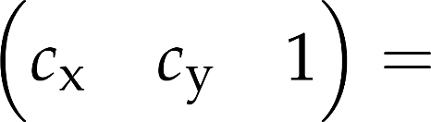
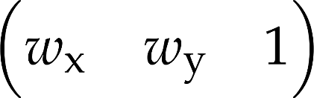


1
1

Slide 19

1
1

Slide 20
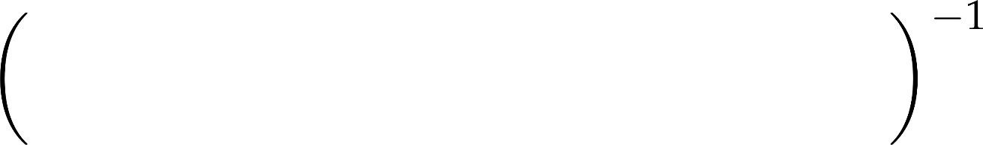
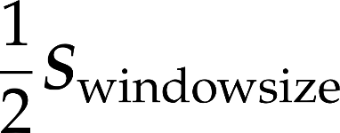


1
1

Slide 21
OrthoCamera concept
2d camera
must scale and translate everything
so that desired window of the virtual world shows on viewport
resize camera window if canvas aspect ratio changes
it is a UniformProvider component
provides the camera matrix (a.k.a. viewProjMatrix) and eye position
let us make all programs its children

Slide 22
OrthoCamera.js – initial pos, zoom
.
"use strict";
/* exported OrthoCamera */
class OrthoCamera extends UniformProvider {
constructor(...programs) {
super("camera");
this.position = new Vec2(0.0, 0);
this.rotation = 0;
this.windowSize = new Vec2(2, 2);
this.addComponentsAndGatherUniforms(...programs);
}

Slide 23
OrthoCamera.js – construct V
.
update () {
this.viewProjMatrix.set().
scale(0.5).
scale(this.windowSize).
rotate(this.rotation).
translate(this.position).
invert();
}

Slide 24
OrthoCamera.js – aspect ratio
.
setAspectRatio(ar) {
this.windowSize.x = this.windowSize.y * ar;
this.update();
}

Slide 25
Set aspect ratio in Scene#resize
.
resize(gl, canvas) {
gl.viewport(0, 0, canvas.width, canvas.height);
this.camera.setAspectRatio(
canvas.clientWidth /
canvas.clientHeight );
}
draw over entire canvas
adjust camera scaling so that the world space window mapped to the viewport has the same aspect ratio as the viewport (no distortion)

Slide 26
Task: use camera
!
create a camera in Scene's constructor
pass the camera to GameObject#draw
in the vertex shader, multiply the world space position with the uniform camera.viewProjMatrix to get the ndc position (a.k.a. gl_Position)

Slide 27
Task
!
the camera should follow one of the objects
set camera position in every frame
call OrthoCamera#updateViewProjMatrix afterwards

